Slide 1
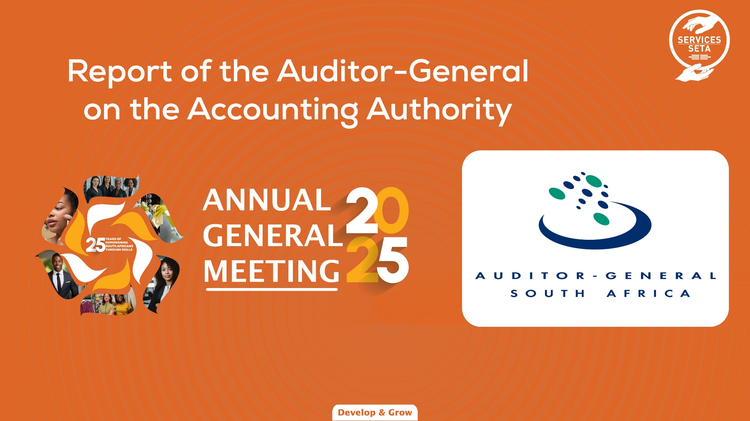

Slide 2
Service Sector Education and Training Authority (Service SETA) Audit outcome 2024-25
26 November 2025

Slide 3

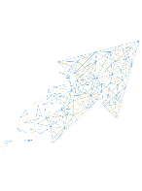

Our mission to advocate for an effective government cultures
MISSION
The Auditor-General of South Africa has a constitutional mandate and, as the supreme audit institution of South Africa, exists to strengthen our country’s democracy by enabling oversight, accountability and governance in the public sector through auditing, thereby building public confidence.
Implement and maintain institutionalised controls to ensure leadership and officials behave ethically, comply with legislation and act in best interest of institution, avoiding conflicts of interest
Demonstrate commitment to improving lived realities of South Africans by delivering on legislated mandate and strategic objectives aligned to people’s needs, being financially sustainable, and avoiding harm to public and public sector institutions
PERFORMANCE
VISION
To be recognised by all our stakeholders as a relevant supreme audit institution that enhances public sector accountability
INSTITUTIONAL INTEGRITY
CULTURE
ACCOUNTABILITY
TRANSPARENCY
Be responsive to public, oversight and other stakeholders through reporting and providing answers on mandated responsibilities fulfilled, actions taken and decisions made; ensure swift consequences for transgressions and poor performance
Provide public, oversight, auditors and other stakeholders with timely, relevant and reliable information on institution’s finances, performance, use of resources and compliance with legislation
Notes:
Audit outcomes – Overall
Audit outcomes continued to improve over the term of the current administration and the number of clean audits increased.
The audit outcomes of both departments and public entities improved and more auditees improved their audit outcomes each year than regressed over the term of this administration. In 2022-23, the net improvement was 37 auditees (9%) – the biggest movement over the four-year period.
Based on the completed audits of a 160 departments, 54 departments had improved their audit outcomes since 2018-19 while nine had regressed – a net improvement of 45 (28%). Similarly, of the 227 public entities with completed audits, 73 had improved and 40 had regressed – a net improvement of 33 (15%). Provincial government showed a net improvement of 44 (27%) and national government a net improvement of 34 (15%).
In 2022-23, accounting officers and authorities managed an estimated expenditure budget of R3,10 trillion in national and provincial government. We obtained this amount through the audit process: it includes all the funds departments and public entities budgeted for operating expenditure (needed to run day-to-day operations) and capital expenditure (needed to provide services and to acquire, upgrade and maintain assets and infrastructure).
The combined number of auditees with unqualified audit outcomes (green and yellow category) adds up to 309 or 74%. This is consistent to 2021-22 with a similar percentage of auditees publishing credible financial statements.
Note to AG
Reconciliation of number of auditees:
GR applicable auditees 2021-22 424
Less: Dormant (Densecure) -1
Less: Closed -6
Arts and Culture - KZN
Sport & Recreation - KZN
Estate Agency Affairs Board
LMT Holdings
LMT Products
South African Express Airways
Less: Small auditees -2
Property Practitioners Fidelity Fund
KwaZulu-Natal Sharks Board
Sub-total 415
Add: New auditee 1
KZN Dept of Sport, Arts and Culture
Add: Non AGSA taken back 2
Alexkor
Housing Development Agency
TOTAL auditees – 2022-23 418
Outstanding audits
The number of auditees that submitted their financial statements on time in 2022-23 reduced slightly to 91%, from 92% last year.
When we tabled last year’s general report, 26 audits were outstanding either because the auditees had submitted their financial statements late or not at all, or because of other delays caused by the auditees. Three of these auditees have since closed down (LMT Holdings, LMT Products [both Denel subsidiaries] and South African Express Airways) and one became dormant (Densecure), which means their outcomes are no longer reported in the general report. We finalised the audits of 10 of the remaining 22 auditees.
By 30 September 2023 (the cut-off date for audit outcomes to be included in this report), the audits of 31 auditees were outstanding:
7 public entities (four in the South African Airways group - outstanding since 2018-19 and three in the North West Transport Investments group – outstanding since 2019-20) due to non-submission of financial statements
3 public entities (the Denel group) – outstanding since 2020-21 due to late submission of financial statements
2 public entities (Compensation Fund and Coastal KZN TVET College) – outstanding since 2021-22 due to non-submission of financial statements
8 public entities – outstanding for 2022-23 due to late submission of financial statements (6 public entities [Air Chefs; Mango Airlines; SAA Technical; Alexkor; PRASA; Ingonyama Trust]) and non-submission of financial statements (2 public entities [(Compensation Fund and UIF)])
10 public entities – outstanding for 2022-23 due to other delays caused by the auditees [(Agriculture and Land Holding Account; Local Government SETA; Mayibuye Transport Corporation (EC); Railway Safety Regulator; SIU; PetroSA; SFF; African Exploration (CEF group subsidiary); Government Printing Works; Road Traffic Infringement Agency)]
1 department (Limpopo Department of Health) – outstanding for 2022-23 due to other delays caused by the auditee
Note to AG:
Audits outstanding in 2018-19:
South African Airways
Air Chefs
SAA Technical
Mango Airlines
Clean audits
When an auditee receives a clean audit opinion, it means that its financial statements and performance report give a transparent and credible account of its finances and its performance against set targets. In other words, these accountability reports present a reliable picture of that auditee’s performance – whether good or bad. This enables everyone with an interest in the auditee – particularly those who need to oversee the auditee’s performance and provide support for it to succeed – to judge how the auditee is doing and to take action where necessary. A clean audit opinion also means that the auditee complied with the important legislation that applies to it and, where transgressions did occur, they were rare or not material.
A clean audit is not always an indicator of good service delivery. However, a clean audit opinion positions an auditee to transparently communicate to citizens on whether and when their needs will be met through accurate records, which also enables informed decisions by the different roleplayers in the accountability ecosystem. We have seen that auditees with institutionalised controls and systems to plan, measure, monitor and account for their finances and performance, and to stay within the rules, often also have a solid foundation for service delivery to the people of South Africa.
The number of clean audits increases every year due to significant effort and commitment by the leadership, officials and governance structures of these auditees. The 147 auditees (62 departments and 85 public entities) that achieved clean audits in 2022-23 managed 16% of the R3,10 trillion expenditure budget in national and provincial government.
Movement in number of clean audits since previous year
Improved to clean audit status 37
Sustained clean audit status 110
Lost clean audit status 14
Outstanding audits 2
Close to clean audit status 37
Each of the 37 auditees that is very close to obtaining a clean audit opinion only needs to address one finding on either the quality of its financial statements (31 auditees) or on its performance reporting (six auditees). For example, the Ithala Development Finance Corporation (KwaZulu-Natal), the Limpopo Tourism Agency (Limpopo) and 19 auditees in the higher education and training portfolio each only had one finding on material misstatements in its submitted financial statements.
Some of these auditees have been working towards this goal for many years and we encourage them to persevere in overcoming the last hurdle. If they manage to do so, we expect to see an increase in the number of clean audits for 2023-24.
An auditee will often find it difficult to sustain a clean audit if it does not have financial and performance management systems that operate consistently and effectively, and controls that are properly embedded.
We commend the 53 auditees (36%) that have managed to retain their clean audit status over the term of this administration. They achieved this through practices such as institutionalising and monitoring key controls (including preventative controls), and by having all roleplayers in the accountability ecosystem (including management and leadership) committed to fulfilling their monitoring, governance and oversight roles. They should continue to do so to avoid any possible regressions.
Note to AG: (see separate schedule)
Breakdown of 53 auditees:
National auditees 22
Eastern Cape 4
Gauteng 4
KwaZulu-Natal 4
Mpumalanga 1
Northern Cape 2
North West 1
Western Cape 15
Disclaimed and adverse outcomes
The number of auditees with disclaimed audit opinions decreased. If the auditees with outstanding audits also receive disclaimed opinions, the improvement in this area will be less significant, but should still be acknowledged.
The following auditees received disclaimed audit opinion in 2021-22:
Alexkor
Central Johannes burg TVET
Government Printing Works
Passenger Rail Agency of South Africa
There was an increase in adverse audit opinions due to three public entities improving from disclaimed last year to adverse in 2022-23, while one improved out of this category and another regressed into it. [Free State Dev Corporation; RAF; Sheltered Employment Enterprises; Ehlanzeni Tvet College]
Audit outcomes of legislature sector
We specifically include the legislature sector in the general report as Parliament and the provincial legislatures have an important role to play in the accountability ecosystem.
These auditees are not governed by the Public Finance Management Act, but rather by the Financial Management of Parliament and Provincial Legislatures Act.
The legislature sector is independent from national and provincial government and are therefore:
ideally placed to oversee executive action and perform specific oversight functions relating to various aspects of government operations;
ensure that government is accountable for its decisions, is transparent in its dealings,
and is responsive to the needs of its people.
The audit outcomes of the sector have improved significantly over the term of this administration, and all but one auditee in this sector (North West Provincial Legislature) have now attained a clean audit status.
Nine of the 10 auditees in this sector are now well positioned to provide credible oversight of national and provincial government’s actions and financial practices, and to facilitate accountability for government performance and spending.
The North West Provincial Legislature must address its compliance findings on expenditure and procurement management to also progress to a clean audit status.
Audit outcomes of state-owned enterprises
The Public Finance Management Act lists 21 ‘major’ public entities under schedule 2.
Commonly known as state-owned enterprises, they were established as independent entities to achieve the various socioeconomic goals of government.
Government, through the respective executive authorities (ministers), is the sole shareholder of these entities.
In previous general reports, we consistently highlighted the need to pay specific attention to these entities because of the big impact they have on service delivery and government’s financial health.
Their audit outcomes are a good indicator of their ability to fully discharge their mandate.
We do not analyse the following two entities in this report:
South African Express Airways, which was liquidated during 2021-22
Telkom, which is not considered a public entity that falls under our mandate
We currently audit 15 of the remaining 19 state-owned enterprises (79%), compared to 14 (70%) five years ago.
Private-sector auditors audit the other four (Air Traffic and Navigation Services; Broadband Infraco; Eskom; Industrial Development Corporation) in accordance with section 4(3) of the Public Audit Act.
There was a net regression in the audit outcomes of the 12 state-owned enterprises with completed audits. The three outstanding audits were for South African Airways and the Denel group, as well as Alexkor, which did not submit its financial statements on time.
While the South African Nuclear Energy Corporation improved its outcome from a disclaimed audit opinion to a qualified opinion with findings, this was offset by two regressions: the Land and Agricultural Development Bank of South Africa regressed from a clean audit outcome to a financially unqualified opinion with findings, and the South African Broadcasting Corporation regressed from a qualified audit opinion with findings to a disclaimed opinion.
Two of the four audits conducted by private-sector auditors were outstanding (Eskom and the Industrial Development Corporation).
Both Air Traffic and Navigation Services and Broadband Infraco retained their financially unqualified audit opinion with findings from the previous year.

Slide 4
Message on overall audit outcomes
2023-24
Overall audit outcome
Financial statements:
Discretionary grants commitment
Provisions
Annual performance report:
No material findings
Compliance:
Annual Financial Statements
Expenditure Management
Overall, the audit outcomes for Service SETA remained stagnant with substantial internal control weaknesses persisting in financial reporting and compliance with applicable legislation.
Current culture
2022-23
2024-25
The reduced number of commitment findings indicates management’s efforts to resolve the prior year’s qualification. However, we stress that lasting improvements in audit outcomes require consistent, coordinated efforts from all stakeholders in executing their roles and responsibilities.
Root causes
Inadequate detailed reviews of the financial information which resulted in material misstatement of the financial statements.
Non-compliance with legislation continues to undermine audit outcomes and highlights the need for stronger compliance culture.
Financial statements:
Discretionary grants commitment
Annual performance report:
Material findings
Compliance:
Annual Financial Statements
Expenditure Management
Financial statements:
Discretionary grants commitment
Provisions
Irregular Expenditure
Annual performance report:
No material findings
Compliance:
Annual Financial Statements
Expenditure Management
Recommendations
Management should enhance project monitoring around their commitment and strengthen the review controls of the AFS to improve audit outcomes.
Review and monitor compliance with the applicable legislation.
Audit outcomes are depicted as follows:
Unqualified with no findings
Unqualified with findings
Qualified with findings
Adverse with findings
Disclaimed with findings
Outstanding audits

Slide 5



Irregular and fruitless and wasteful expenditure
Compliance with key legislation
Annual irregular expenditure
Observation
There was a significant decrease in irregular expenditure which was due to the write off where investigation did not find anyone responsible, however it is important for the entity to ensure that they prevent incurring irregular expenditure
Most common areas of non-compliance | 2023-24 | 2024-25
Quality of financial statements | X | X
Prevention of irregular, unauthorised, and fruitless and wasteful expenditure | X | X
Prepayments made before service were received | X
Impact of irregular expenditure incurred
Breach of five pillars of procurement – equitable, fair, cost effective, transparent and competitive.
Causes of irregular expenditure
Exceeding of the 7.5% project administration cost limit
Allocation of the discretionary grants not following a correct process.
Awards with variations above the 15% limit.
Observation
Compliance remains a concern for Service SETA as the quality of the financial statement submitted for audit contains misstatements.
Irregular expenditure is not prevented by the entity and there were prepayments made relating to the discretionary grant's expenditure.
Annual fruitless and wasteful expenditure
Observation
There was no fruitless and wasteful expenditure incurred in the current year. The prior year fruitless and wasteful expenditure was written off as the investigation conducted did not find anyone responsible.

Slide 6


Material irregularities definition and purpose
Material irregularity
If AO/AA does not appropriately deal with MIs, our expanded mandate allows us to:
Progress on the issued MI
MI
Notification: Administrator notified on the 12 September 2025.
Response: Administrator responded to the MI notification on the 13 October 2025.
AGSA Request for more information: On the 27 October 2025 AGSA requested more information to support the response.
Response from the entity: The requested information was submitted with explanations on the 03 November 2025.
Determination on appropriateness of actions taken: AGSA assessment of the responses concluded that appropriate actions are being taken to address the material irregularity.
Conclusion: We will be following up on the actions stipulated on the AA response to confirm implementation thereof
means any non-compliance with, or contravention of, legislation, fraud, theft or
a breach of a fiduciary duty identified during an audit performed under the Public Audit Act that resulted in or is likely to result in a material financial loss, the misuse or loss of a material public resource, or substantial harm to a public sector institution or the general public.
1
Refer material irregularities to relevant public bodies for further investigation
Recommend actions in audit report to resolve the material irregularities
2
Take binding remedial action for failure to implement recommendations
3
Issue certificate of debt for failure to implement remedial action if financial loss was involved
Original expanded mandate now finding its basis in our strategy
Overall aim of our expanded mandate:
Enforcement
Apply powers to directly and indirectly recover resources lost to the state and taxpayers, and ensure application of consequences for wrongdoing – #cultureshift2030
Instil a culture of accountability
Improve the protection of resources
Enhance public sector performance and encourage an ethical culture
Strengthen public sector institutions to better serve the people of South Africa
Enable effective oversight

Slide 7


