Slide 1
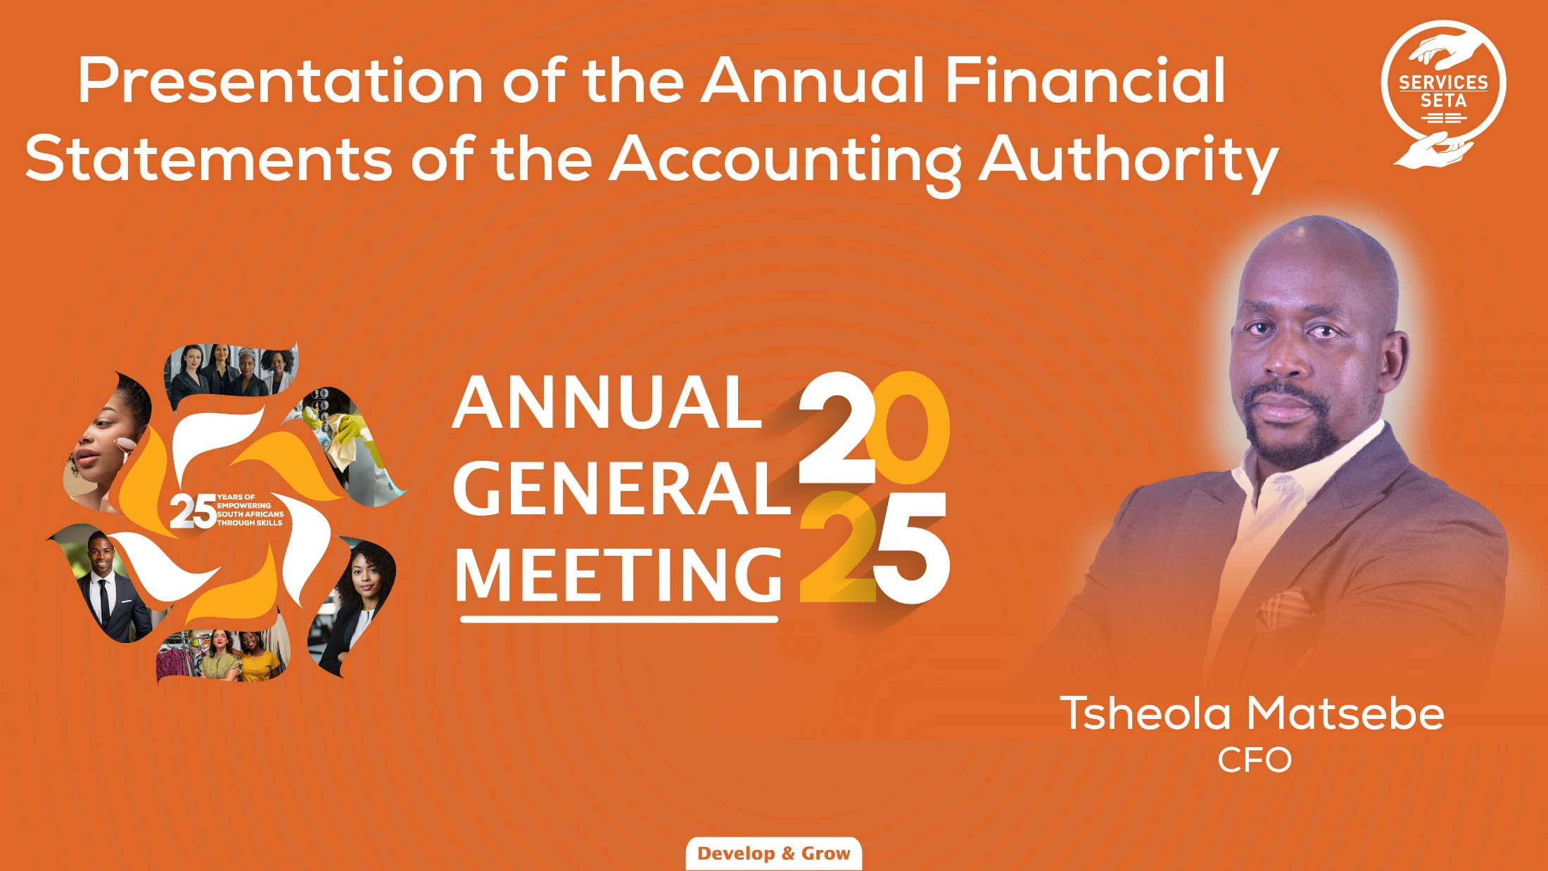

Slide 2

2024/25 ANNUAL FINANCIAL STATEMENTS
CHIEF FINANCIAL OFFICER – TSHEOLA MATSEBE

Slide 3
AGENDA
01
02
03
STATEMENT OF FINANCIAL POSITION
STATEMENT OF FINANCIAL PERFORMANCE
COMPLIANCE WITH LEGISLATION
R3,4 B
04
R2 B
2025-26 PLAN OF ACTION

Slide 4
STATEMENT OF FINANCIAL POSITION

Slide 5
Statement of Financial Position
Current Liabilities
R513 M (FY 2024: R488 M)
Current Assets
R4.1 B (FY 2024: R3.2 B)
DG COMMITMENTS
R3,4 B
R2 B
Total reserves
R3.7 B (FY 2024: R2.8 B)
Non-current assets
R143 M (FY 2024: R125 M)

Slide 6





STATEMENT OF FINANCIAL PERFORMANCE
Total Revenue – R2.4 B (FY2024:R2,1 B)
Total Admin exp. – R479 M (FY2024: R395 M)
Levies – R2,1 B (FY 2024: R1,9 B)
Other – R318 M (FY 2024: R219 M)
10.5% - R409 M (FY 2024: R258 M)
7.5% - R70 M (FY 2024: R36 M)
Surplus
Total Grants– R1.1 B
R886 M (FY 2024: R927 M)
MG (20%) – R278 M (FY 2024: R254 M)
DG (direct) – R795 M (FY 2024: R601 M)

Slide 7
COMPLIANCE WITH LEGISLATION

Slide 8



Compliance with Legislation
01
Payment after 30 days
Irregular expenditure (new) R7 M– exceeding 7.5% limit per Grant Regulation
02
03
Irregular balance – R588 M
04
Fruitless and wasteful balance – R0

Slide 9
2025/26 PLAN OF ACTION

Slide 10



AUDIT ROADMAP
Commitments
Bursary Provision
Financial statements
Assessment by Accounting Firm
Closure by Legal Firm
Interim Audit
Reconciliations and closure with intermediaries
Direct dealing with institutions
Reclassify to accruals
Additional reviews
Adherence to timelines
GRAP compliance

Slide 11
THANK YOU

